Slide 1

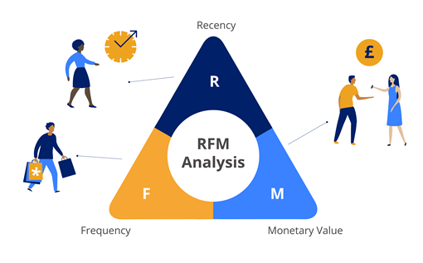
Presented by:
Aayush Sahu
Aji Thomas
Anirudh Pratap Singh
Olive Olemmyan

Slide 2
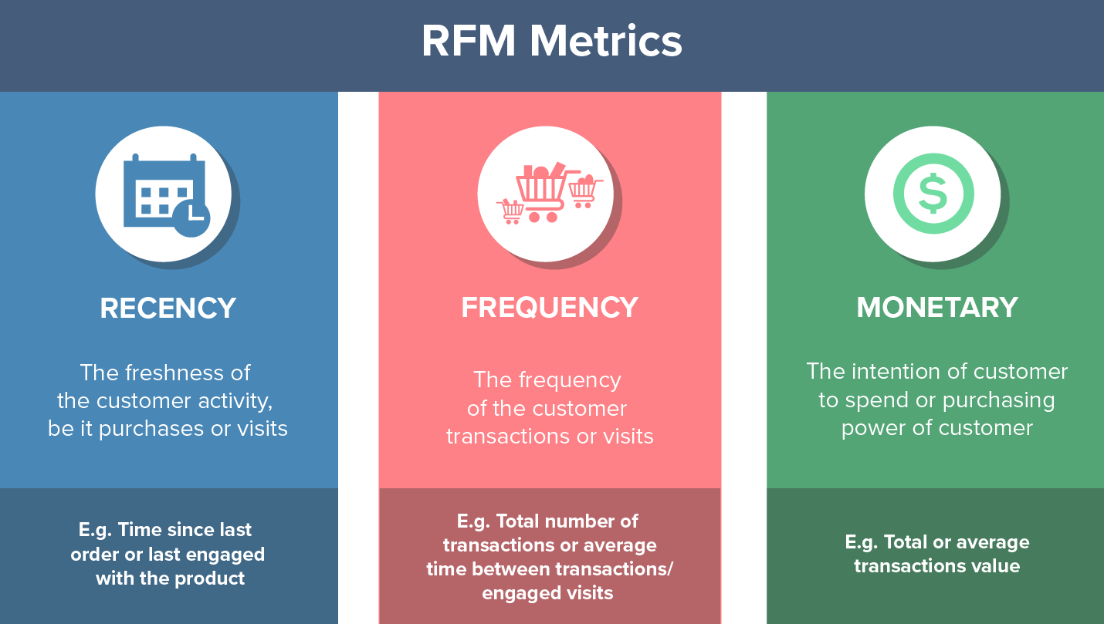
WHAT IS RFM?
Recency, Frequency and Monetary analysis measures how recently, how often, and how much money a customer has given your brand.
RFM Analysis helps marketers answer-
Who are their best customers?
Which of their customers could contribute to churn rate?
Who has the potential to become valuable customer?

Slide 3
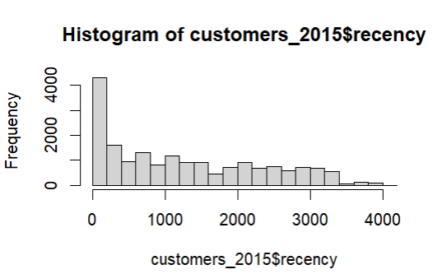
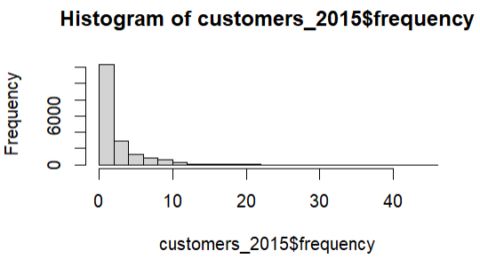
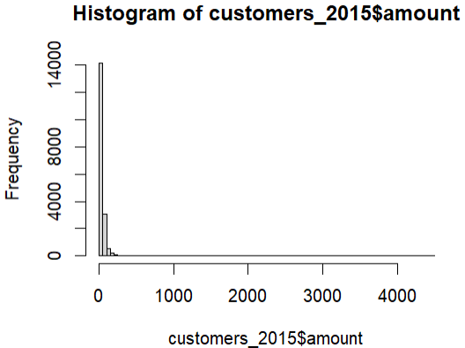
Data and Insights
Data and Analysis
51244 transactions data
18,417 unique customers
Omitted out inactive customers who did not had any transaction in last 3 years

Slide 4
Criteria
RFM Score | Count
111 | 1061
112 | 483
113 | 16
121 | 186
122 | 71
123 | 6
131 | 54
132 | 25
133 | 1
211 | 1158
212 | 587
213 | 43
221 | 357
222 | 161
223 | 16
231 | 172
232 | 102
233 | 6
311 | 1554
312 | 859
313 | 81
321 | 753
322 | 486
323 | 36
331 | 572
332 | 372
333 | 42
Grand Total | 9260
Recency
Frequency
Monetary
R score
F score
M Score
< 90 days
3
90 - 730 days
2
> 730 days
1
>= 8 times
3
4 - 8 times
2
< 4 times
1
>= $250
3
2
< $50
1
$50 -$250

Slide 5
Customers Segmentation
Champions
Potential Loyalist
Potential Loyalists are your recent customers with high to average frequency and who spend a good amount.
New Customers
New Customers have good overall RFM score but are not frequent shoppers.
At- Risk Customers
Champions are your best customers, who bought most recently, most often and are heavy spenders.
At-Risk Customers are your customers who purchased often and spent big amounts, but haven’t purchased recently.
Can't Lose Them
Can’t Lose Them are customers who used to visit and purchase quite often, but haven’t been visiting recently.
Can Lose Them
Can Lose Them are customers who visit very rarely and have not purchased recently.

Slide 6
Segmentation, RFM Score and Size
Champions
Potential Loyalist
New Customers
At- Risk Customers
Can't Lose Them
Can Lose Them
450
2340
4282
102
542
1544
333, 332, 323
331, 321, 322, 231, 221
312, 311, 313, 213, 212, 211
121, 131, 133,223, 233,222,232,113
111, 112
123, 132, 122

Slide 7
Marketing Action
Most Important : Potential Loyalists
Upsell them with memberships, loyalty programs, or recommend related products to help them become Champions.
Most Sizable : New Customers
Start building relationships with these customers by providing onboarding support plus special offers to increase their visits.

Slide 8

THANK YOU!

